Slide 1
PSYC100 GENERAL PSYCHOLOGY
WHAT IS PSYCHOLOGY? PSYCHOLOGY AS A SCIENCE
Dr. Asli Niyazi
nasli@metu.edu.tr

Slide 2
PSYC100 Course Outline
 | Attendance | Attendance will be taken in all sessions. **Students who do not attend 70% of classes will not qualify for taking the final exam and be given an NA grade. Therefore, will not be able to benefit from the make-up exams**
 | Mid-Terms | Date: Week 7 and Week 12 Weighing: 30% each Format: MCQs Coverage: Weeks 1-6 & Weeks 8-11, respectively.
 | Final Exam | Date: TBA Weighing: 40% Format: MCQs Coverage: All

Slide 3
PSYC100 Course Outline

Slide 4
Learning Outcomes
What is psychology?
A brief history
The relationship between psychology and other disciplines
Main areas of psychology
The scientific study of human behaviour

Slide 5
What is psychology?
The word ‘psychology’ is derived from the Greek psyche (mind, soul or spirit) and logos (knowledge, discourse or study). Literally, then, Psychology is the ‘study of the mind’.
Psychology is the scientific study of the mind, brain, and behaviour, exploring thoughts, emotions, and actions to understand individuals and groups. It's a diverse, interdisciplinary field that uses research and experimentation to gain insights into human development, mental processes, and the factors—biological, social, and environmental—that influence how we think, feel, and behave.

Slide 6
A brief history
1879 Wilhelm Wundt opens first experimental psychology lab in Leipzig - Psychology separates from philosophy, becoming an independent science focused on introspection and experimentation.
1883 Stanley Hall opens first U.S. psychology lab at Johns Hopkins - Expanded scientific psychology globally, emphasizing research.
1885 Hermann Ebbinghaus publishes on memory experiments - Demonstrated systematic self-experimentation, solidifying cognitive psychology's scientific basis.
1886 Sigmund Freud begins psychoanalysis - Introduced talk therapy and unconscious mind theories, adding depth to scientific inquiry into mental processes.
1888 Cattell publishes on mental tests - Advanced psychological assessment with standardized measurements, enhancing scientific rigor.

Slide 7
A brief history
1892 formation of American Psychological Association - Professionalized the field, fostering scientific collaboration and standards.
1904 Ivan Pavlov’s work on classical conditioning - Introduced behavioral experiments, shifting focus to observable responses and scientific objectivity.
1905 Binet first IQ test - Developed empirical tools for measuring cognition, advancing psychometrics as a science.
1912 Gestalt Psychology - studies of perception, enriching scientific approaches.
1913 - 1920 Watson’s Behaviourism and Little Albert Experiment - emphasized experimentation over introspection
1932 Jean Piaget - Used empirical observation to map child cognition, establishing developmental psychology as a science.

Slide 8
A brief history
1935
Skinner’s Operant Conditioning experiments - Built on behaviorism with rigorous experiments on reinforcement, solidifying scientific behavior analysis.
1950s
1960s Cognitive revolution (e.g., Noam Chomsky, George Miller) - Shifted to scientific study of mental processes using computer models, integrating with information science
1960s–1970s
Rise of neuroscience and psychopharmacology - Linked psychology to brain science via tools like EEG and MRI, enhancing biological validity.

Slide 9
A brief history
1980s–1990s Positive psychology emerges (Martin Seligman) - Focused on empirical study of well-being and strengths, expanding beyond pathology
2000s Integration of genetics and psychology (e.g., behavioral genetics) - Used scientific methods like twin studies to explore heritability of traits.
2010s Digital psychology and big data - Leveraged technology for large-scale behavioral analysis, making psychology more data-driven.
2021–2023 Studies on social media, loneliness, and AI-inspired models - Empirical research on modern issues like TikTok's impact on adolescents and machine learning in cognitive modeling.
2024–2025 Advancements in AI therapy, telehealth, digital therapeutics etc. - Psychology integrates with tech (e.g., AI chatbots for mental health, brain-computer interfaces) and neuroscience (e.g., immune system's role in anxiety), expanding access and precision in evidence-based interventions.

Slide 10
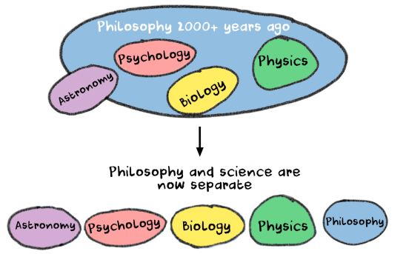

Slide 11
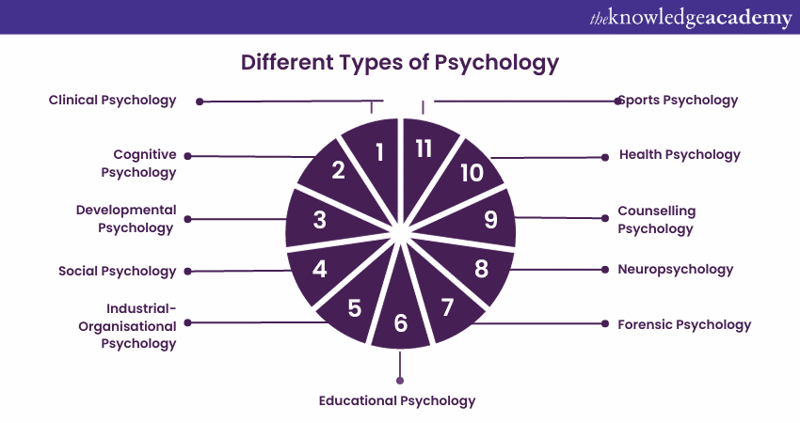
Main areas of psychology

Slide 12
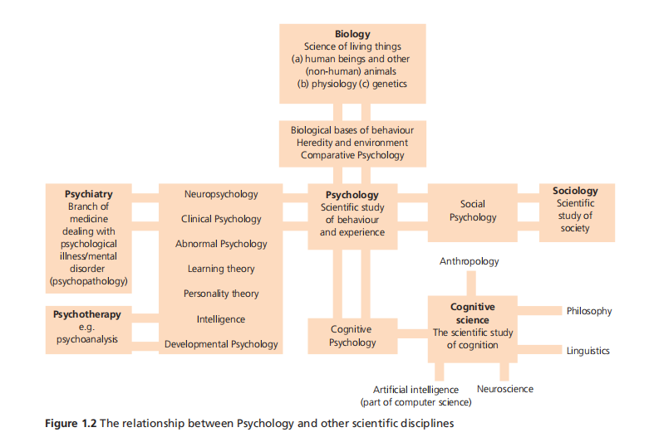
The relationship between psychology and other disciplines

Slide 13
Does psychology have deep connections with other fields?
Computer engineering
Software engineering
Industrial engineering
Mechanical engineering
Civil engineering
Electrical & Electronic engineering
Chemical engineering
Aerospace engineering
Also Business Administration, Economics, Political Science, EFL

Slide 14
Some examples
Mechanical engineering: understanding human error and stress when designing systems.
Civil engineering: how buildings, cities affect mental health and behaviour.
Electrical & Electronic engineering: designing devices that monitor stress, mood or cognitive performance.
Chemical engineering: working with neuropsychologists to develop drugs that affect the brain.
Aerospace engineering: aviation psychology, studying pilot cognition, fatigue and decision-making.
Computer engineering: HCI, user experience, cybersecurity, AI.
EFL: effective language teaching and learning involve understanding cognitive, emotional, social, and motivational processes.
PSIR: human behavior, cognition, and emotions underpin political and international dynamics

Slide 15
The scientific study of human behaviour
Wilhelm Wundt - the founder of the new science of Experimental Psychology; used introspection ( looking inside); structuralism (structure of the mind)
William James – functionalism (function of the mind); individual differences
John Watson – critical of introspection; behaviourism, influenced by Pavlov; Little Albert experiment
McCarthy, Chompsky and Miller – cognitive revolution; various academics met to discuss the possibility of producing computer programs that could ‘behave’ or ‘think’ intelligently. These academics included McCarthy (generally attributed with having coined the term ‘artificial intelligence’), Chomsky and Miller.

Slide 16
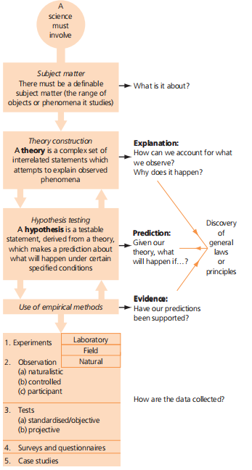
Major features of a science

Slide 17
What makes psychology a science?
Empirical evidence (observable, measurable data collection).
Scientific method (hypothesis testing, analysing results, drawing conclusions).
Theories and models (psychology develops testable theories i.e. cognitive dissonance, attachment theory).
Experimentation (studies cause-effect relationships).
Quantitative and qualitative methods
Falsifiability (theories can be tested and disproven)

Slide 18
The scientific study of human behaviour
The social nature of science: the problem of objectivity - Psychologists are part of their own subject matter, which makes it even more difficult for them to be objective than other scientists.
The Psychology experiment as a social situation
  Experimenter bias - expectations
  Demand characteristics – interpretation of experiment’s purpose
The problem of representativeness
  Culture?
The problem of artificiality
  Generalizability?
The problem of internal vs external validity
  High internal validity means that the observed effects are due to the manipulation of the IV.
  High external validity means results can be generalised to other settings, populations, or times.

Slide 19
Psychology, as a science, seeks to explain the complexities of the human mind through rigorous observation and experimentation.
“
”
Carl Gustav Jung

Slide 20
Summary
While Psychology sometimes faces challenges, like the complexity of human behaviour or ethical limits on experimentation, its commitment to evidence-based methods aligns it with other sciences like biology or physics.
Recognizing and actively addressing the limitations are crucial for maintaining the scientific rigor and validity of psychological research.

